Slide 1
Scala &
Play Framework
Dylan Yang (D.Y.)

Slide 2
Outline
What’s Scala?
Features of Scala: the good, the bad and the ugly
Play Framework
Scala Community & Resources

Slide 3
Who uses Scala?

Slide 4


Slide 5
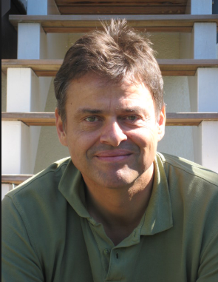
What’s Scala and why should you care ?
Scala == Scalable Language
It is created by Martin Odersky
Designed to express common programming patterns in a concise, elegant, and type-safe way.
Notes:
Scalable means that Scala grows with you. You can play with it by typing one-line expressions and observing the results

Slide 6
Scala Language
Static Language
Few errors
Strongly Typed
Type Inference
Runs on JVM
OOP combine Functional
Concurrency & Distribution

Slide 7
Scala Basics
Variables and Values
Functions
Scala Collections
Traits and Classes

Slide 8
Scala Basics
Variables and Values
Functions
Lambda Function
Closure
Partial Function
Higher-order Function
Scala Collections
Traits and Classes

Slide 9
Scala Basics
Variables and Values
Functions
Lambda Function
Closure
Partial Function
Higher-order Function
Scala Collections
Traits and Classes

Slide 10
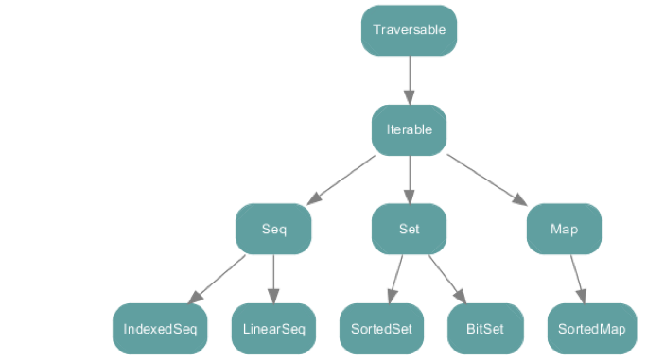
Scala Collections
All collections are immutable in Scala by default

Slide 11
Scala Basics
Variables and Values
Functions
Scala Collections
Traits and Classes

Slide 12
Advanced Features
Case Class and Pattern Match
Futures
Implicit
Reference: http://twitter.github.io/effectivescala/#Functional

Slide 13
Advanced Features
Case Class and Pattern Match
Futures
Implicit

Slide 14
Advanced Features
Case Class and Pattern Match
Futures
Implicit

Slide 15
More features
Actors
Annotations
For Comprehensions
Generics
Lazy evaluation
Partial Applied Function
Call by Name
Curry
Etc…

Slide 16
Pitfalls

Slide 17
The Bad
Heavy in concepts and keywords
Implicits, for comprehensions, lazy, case class, partially applied functions, :/, ~>, :: etc.
Steep learning curve
Coding style: functional v.s. Non-functional
Syntactic Diabetes
Backward Compatibility Issues

Slide 18
Syntactic Diabetes
val tuples = List((1, 345), (3, 42), (5, 432))
val ids = tuples.map(_._1)
val ids = tuples.map( tuple => tuple._1)
val ids = tuples.map{ tuple => tuple._1}
val ids = tuples.map(t => t match { case (id, value) => id})
val ids = tuples.map(_ match {case (id, value) => id })
val ids = tuples.map { case (id, _) => id}
Too many ways to write the same thing
Short v.s. readable
Advanced features getting in the way

Slide 19
Style Guides
The basic: Official Scala-Lang Guide
The conservative: Databricks’ Scala Style Guide
The practical: Strategic Scala Style by Haoyi Li
The effective: Twitter Scala Development Best Practice
Your team’s own style guides
Reference: http://docs.scala-lang.org/style/, https://github.com/databricks/scala-style-guide, http://www.lihaoyi.com/post/StrategicScalaStylePrincipleofLeastPower.html, http://twitter.github.io/effectivescala/

Slide 20
Play Framework

Slide 21

Who Plays?

Slide 22

Play Framework
A full-stack framework for creating scalable, asynchronous web services and applications fast

Slide 23
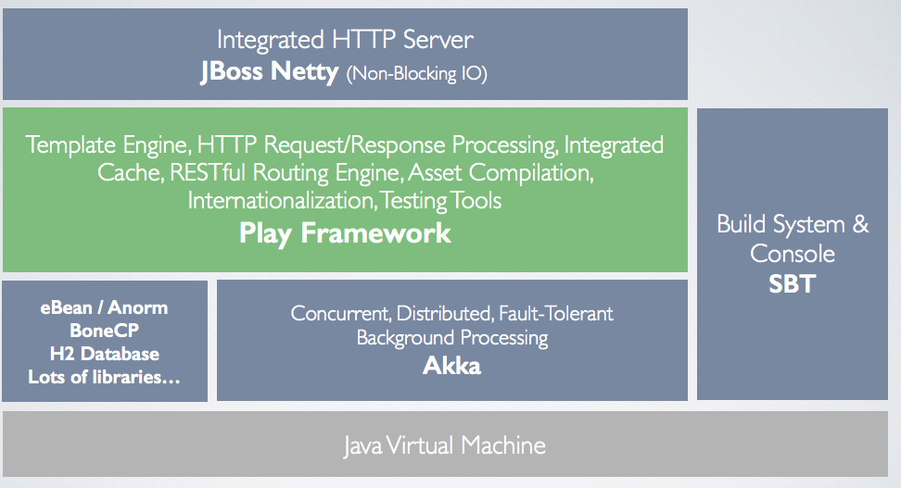
What is Play?
Simple:
Rapid development and iteration
Container-less Asynchronous & Non-blocking
Supports Scala & Java
Open-source!
SOURCE: Play for Java by Nicolas Leroux and Sietse de Kaper

Slide 24
More features
RESTful by default
Supports asset compilers for CoffeeScript, Less, etc..
JSON is a first class citizen
WebSocket and other HTTP Streaming Support
+ Libraries and tools from the JVM
+ Web ecosystems (Angular.js, Ember.js, JPA...)

Slide 25
Play Service in Action

Slide 26
Project Layout
app → Application sources └ assets → Compiled asset sources └ stylesheets → Typically LESS CSS sources └ javascripts → Typically CoffeeScript sources └ controllers → Application controllers └ models → Application business layer └ views → Templates build.sbt → Application build script conf → Configurations files and other non-compiled resources (on classpath) └ application.conf → Main configuration file └ routes → Routes definition public → Public assets └ stylesheets → CSS files └ javascripts → Javascript files └ images → Image files project → sbt configuration files └ build.properties → Marker for sbt project └ plugins.sbt → sbt plugins including the declaration for Play itself lib → Unmanaged libraries dependencies logs → Logs folder target → Generated stuff test → source folder for unit or functional tests

Slide 27
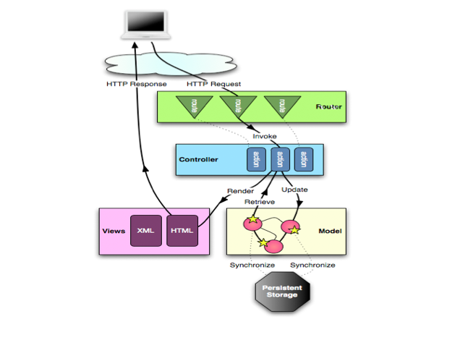
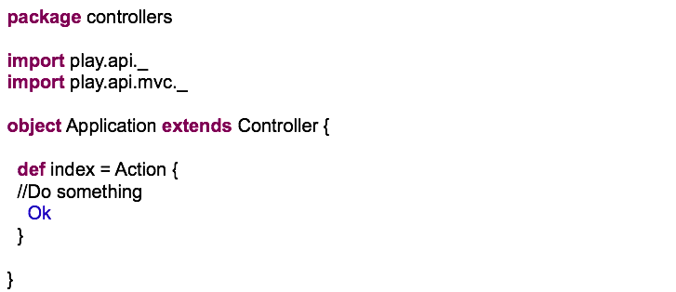



Life cycle of a Request
Takes care of Request

Slide 28
Result Helpers in Play
// 200
Ok(“Hello world”)
// 404
NotFound(<h1>Page not Found</h1>)
// 400
BadRequest(view.html.form(formWithErrors))
// 500
InternalServerError(“Oops”)
// 302
Redirect(“targetURL”)

Slide 29
Let’s Play!

Slide 30
Steps
Download and Install
Create and Run
Routing and Controllers
Templates
ScalaTest

Slide 31
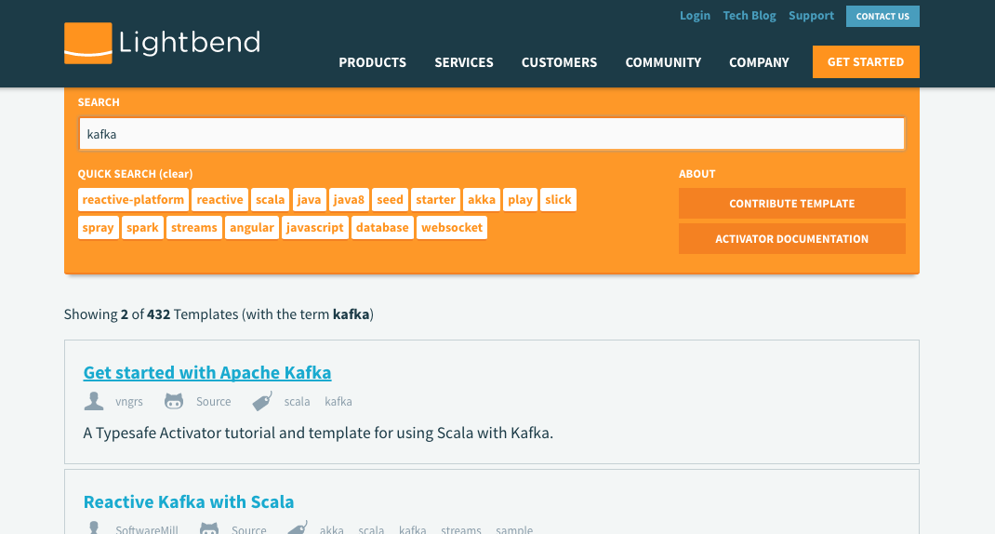
Activator
A browser-based tutorial engine offering 400+ code templates to accelerate learning and productivity

Slide 32
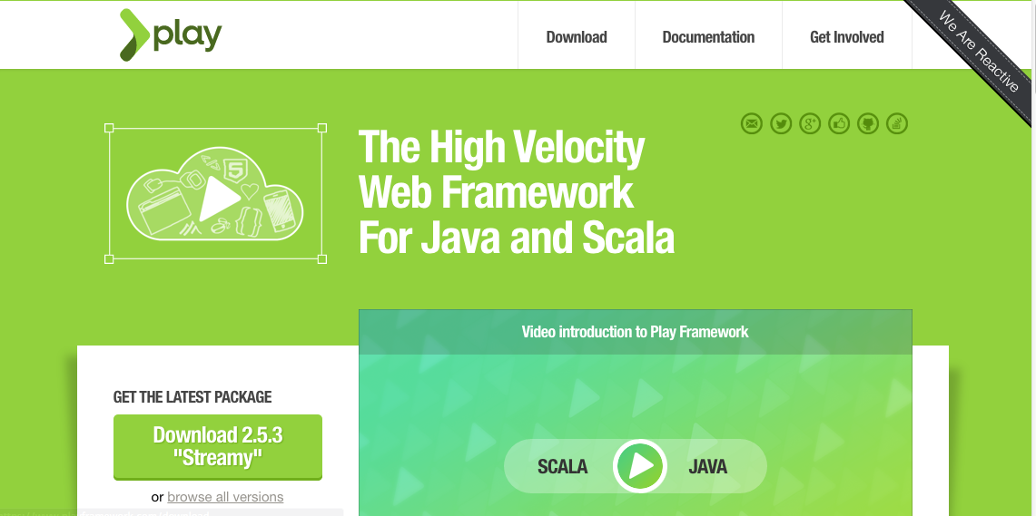
Download & Install: http://www.playframework.com

Slide 33
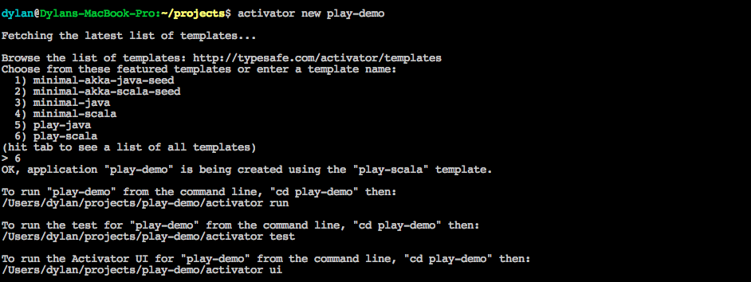
Create New Project from Activator

Slide 34
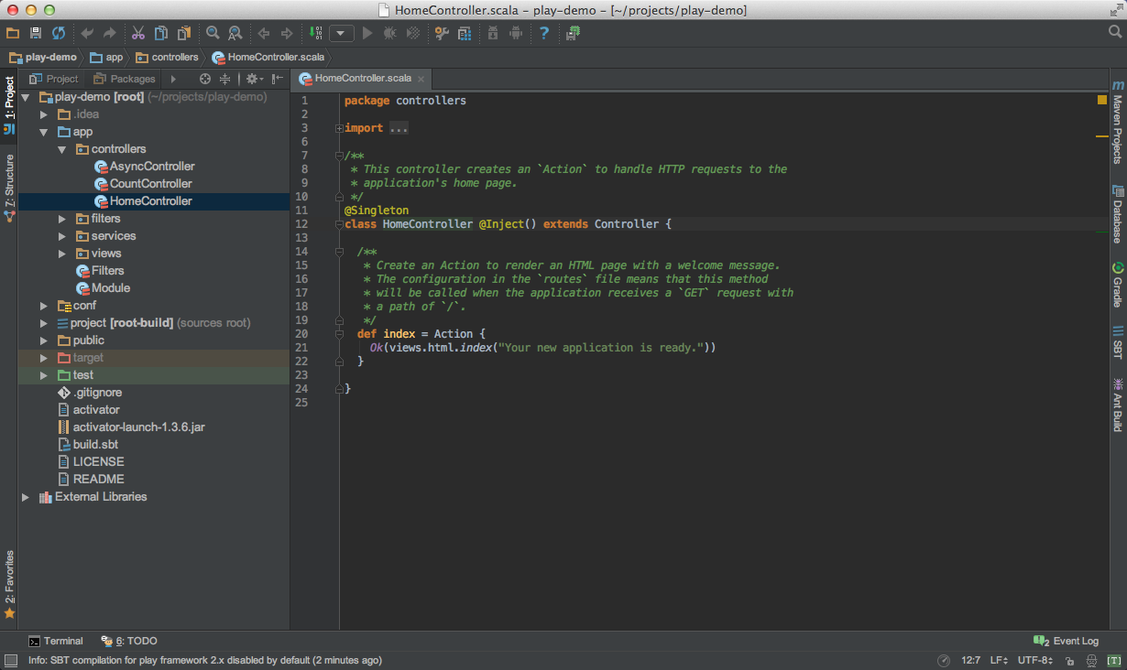
Open your project via IntelliJ IDEA or Eclipse

Slide 35
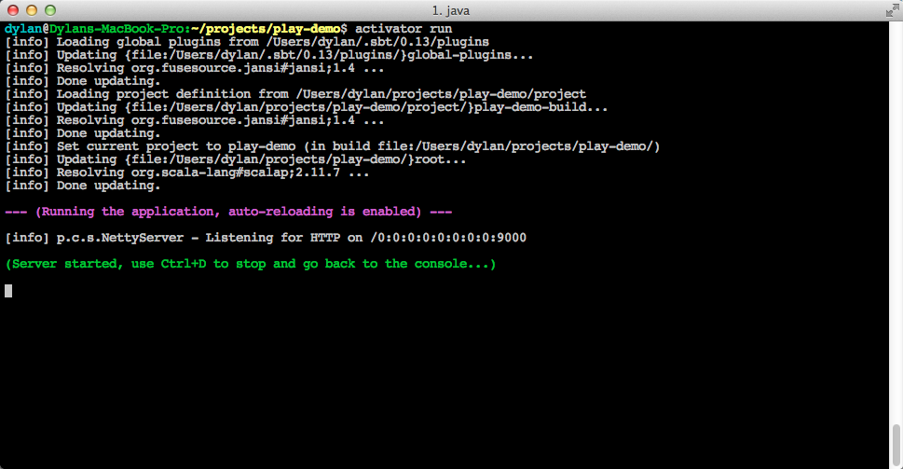
Running on http://localhost:9000

Slide 36
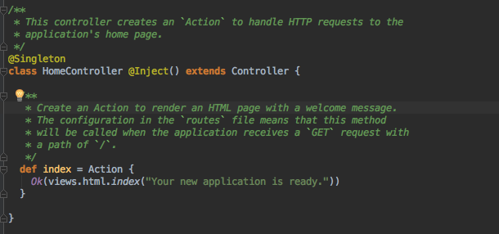
Routing and Controller
routes defined in /conf/routes file

Slide 37
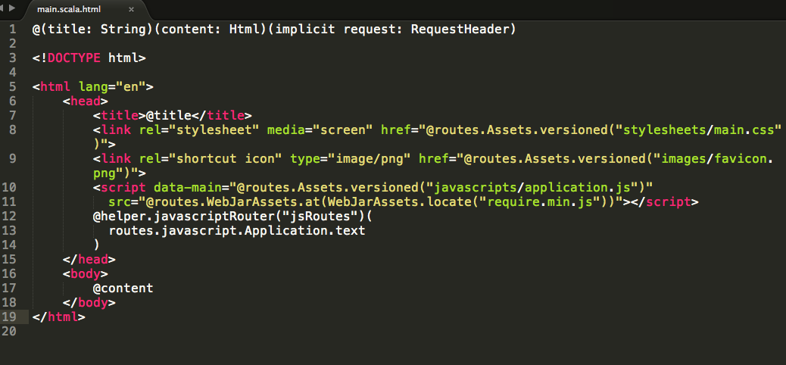
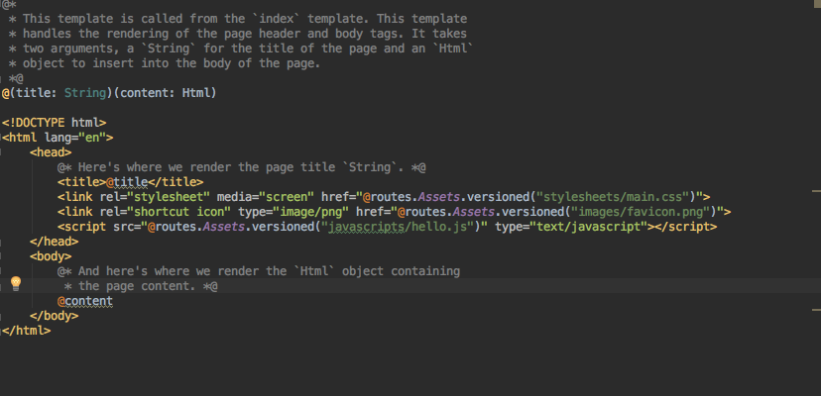
Template

Slide 38
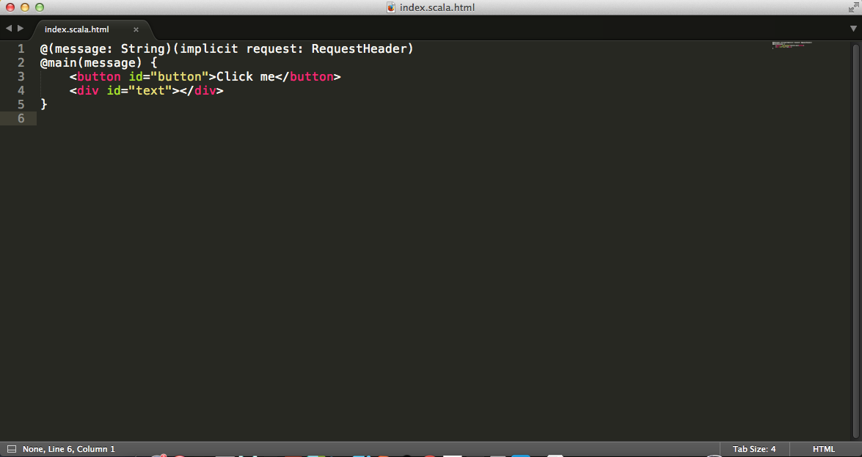
Template

Slide 39
ScalaTest
Play default test framework, the location for tests is in the “test” folder.
You can run tests from the sbt console.
To run all tests, run test.
To run only one test class, run test-only followed by the name of the class, i.e.,test-only my.namespace.MySpec.
To run only the tests that have failed, run test-quick.
To run tests continually, run a command with a tilde in front, i.e., ~test-quick.

Slide 40
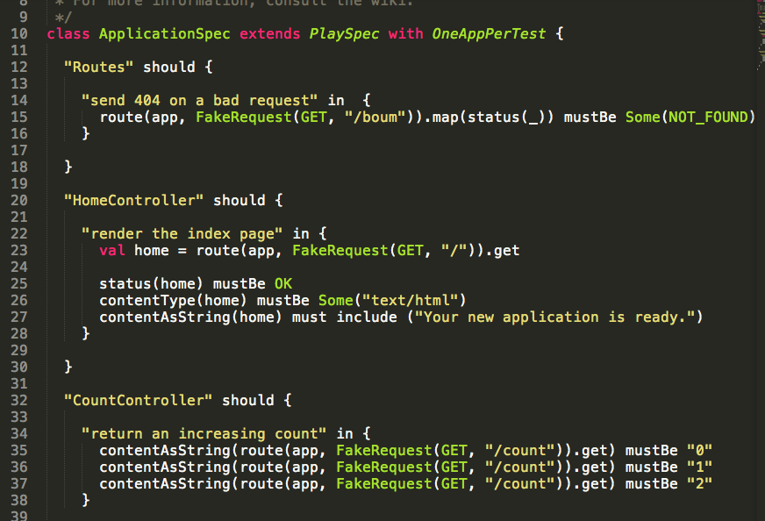

Slide 41
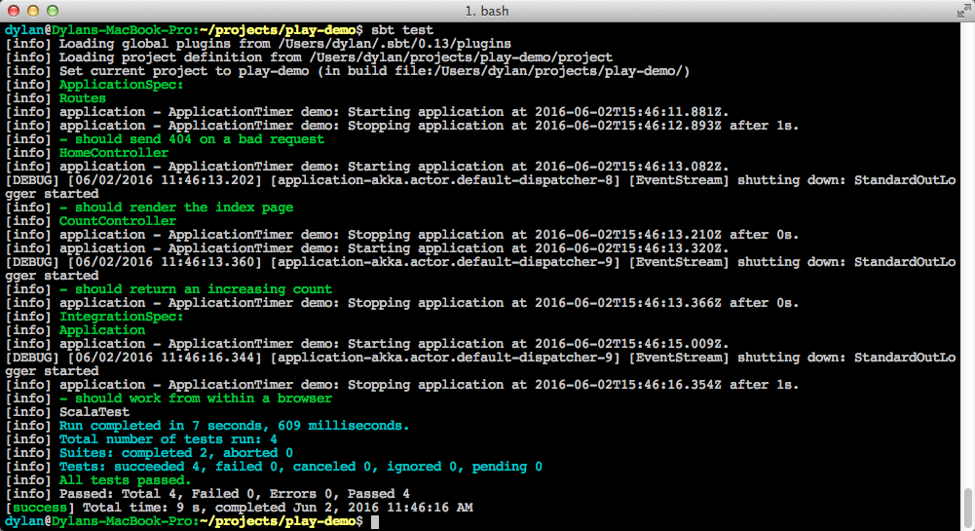

Slide 42
Scala Community

Slide 43
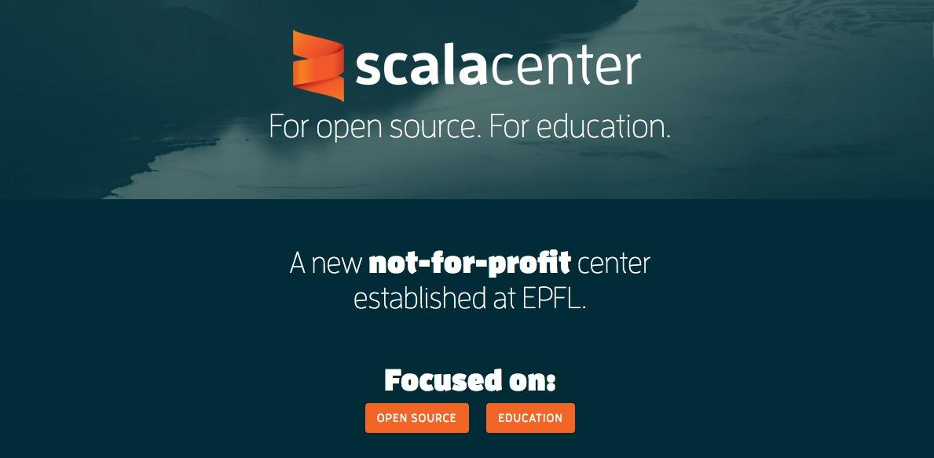
Scala Community - Scala Center
Notes:
Scala center was found on March 2016.

Slide 44
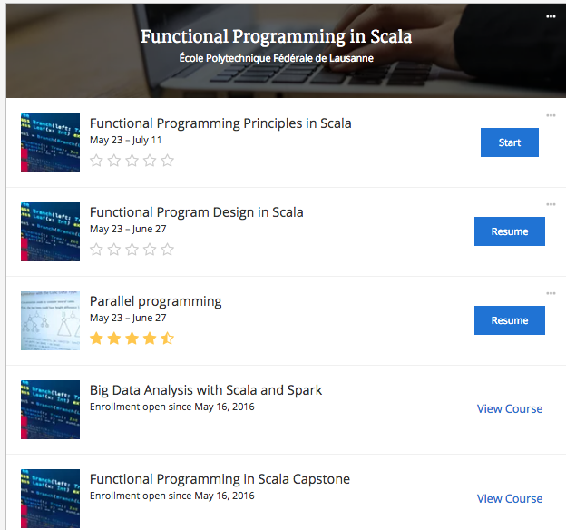
Scala MOOC Courses on Coursera offered by EPFL
Notes:
Coursera 共开放4门scala + 1门capstone project课程， 完成后授予coursera scala mini degree。 开课频率： 每两周新开一期课程

Slide 45
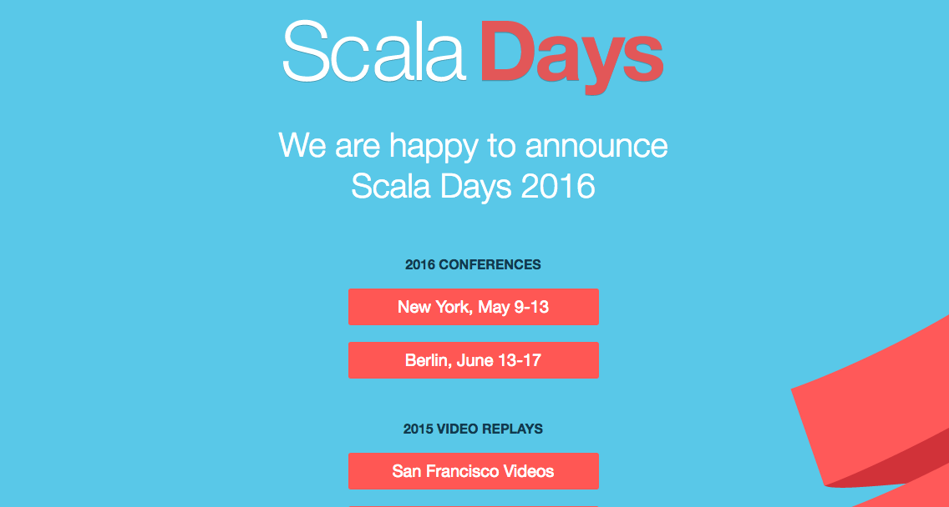
Official Conference: Scala Days

Slide 46
Learning Resources

Slide 47
Learning Resources
Scala Exercises Powered by 47 Deg
Scala School Powered by Twitter
Scala Puzzlers
Interactive Tour

Slide 48
Libraries and Tools

Slide 49
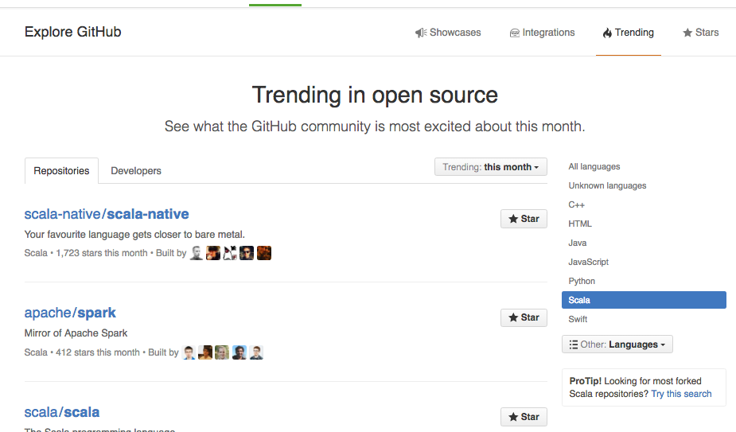
Scala Trend

Slide 50
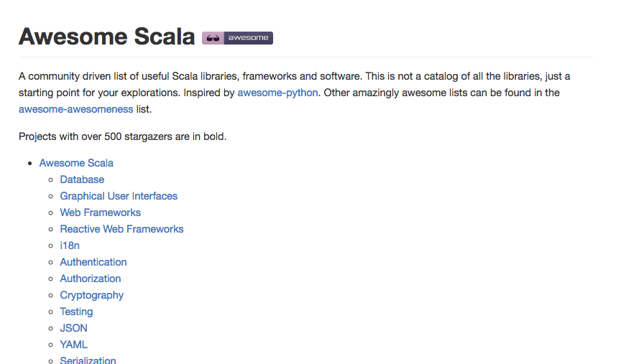
Awesome Scala

Slide 51
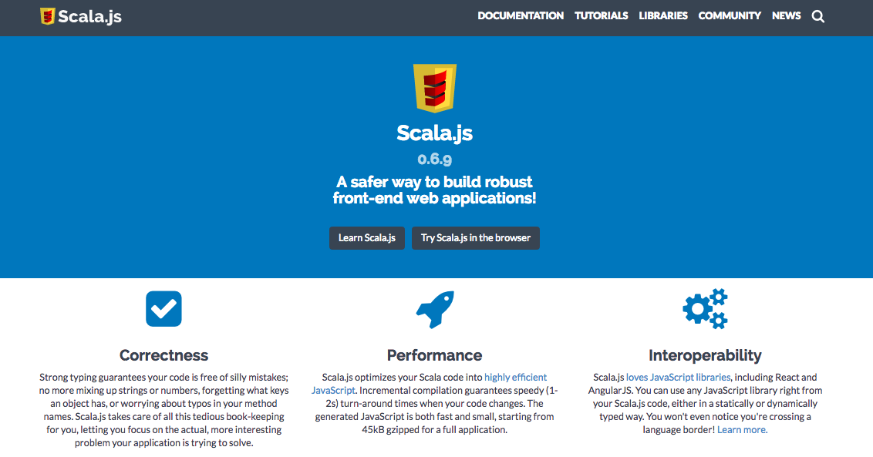
Scala.js

Slide 52
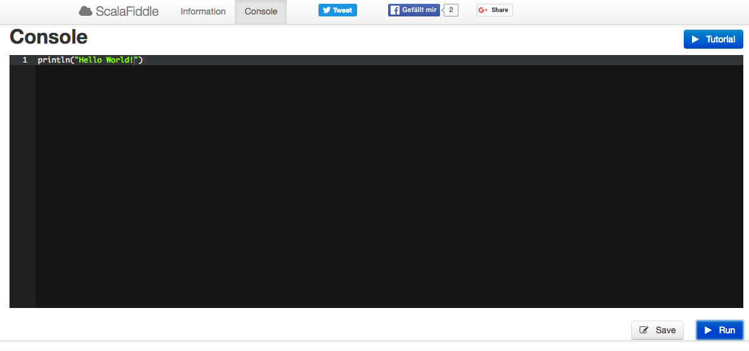
Scala Fiddle

Slide 53
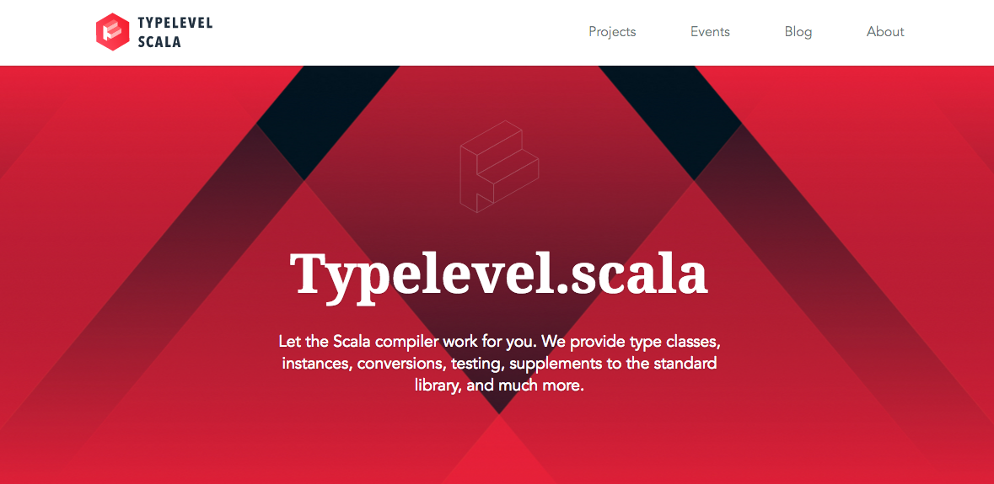
Typelevel.org

Slide 54
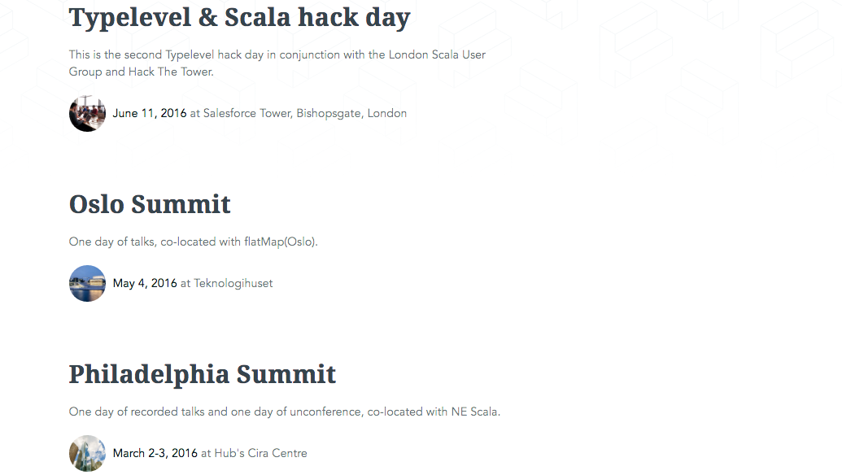
Typelevel.org: Events

Slide 55
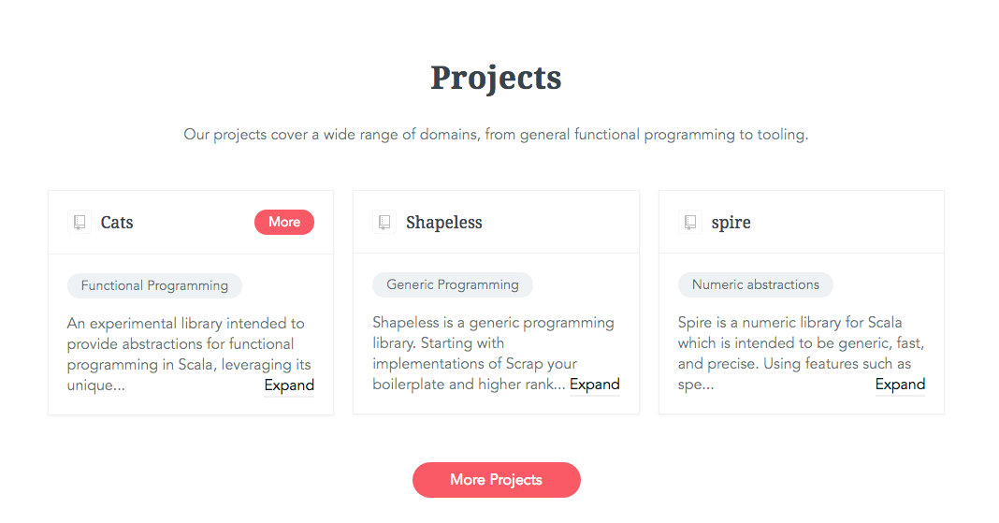
Typelevel.org: Projects

Slide 56
References
http://www.lightbend.com/
http://www.scala-lang.org/what-is-scala.html
http://scala.epfl.ch/
http://www.playframework.com
A Brief Intro to Scala, Tim Underwood
Let’s Play With Scala, Harsh Shama Khandal
Introduction to Scala Lecture 1, CMSC 331 SD Vick

Slide 57
非常感谢T_T
主讲人DY
评委Matt Xu, 裴立全
组织者沈恬, 邹蓉, 小侠, 轮子哥
视频编辑慧敏 文字编辑小太阳
太阁x地区组, 讨论组, 博客组各组长
谢谢BitTiger.io平台
和
你

Slide 58

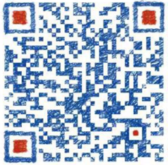



位于西雅图?
加两位区长为好友
一起学习刷题玩耍
轮子哥
小石头
DY Linkedin
问 题
风羽, DY 负责太阁xMOOC组
Scala课程学习小组
欢迎大家微信联系Louis_Hamilton 报名
关注太阁微信
“论码农的自我修养”
获得更多技术分享
微信: bit_tiger
官网: BitTiger.io

